Slide 1
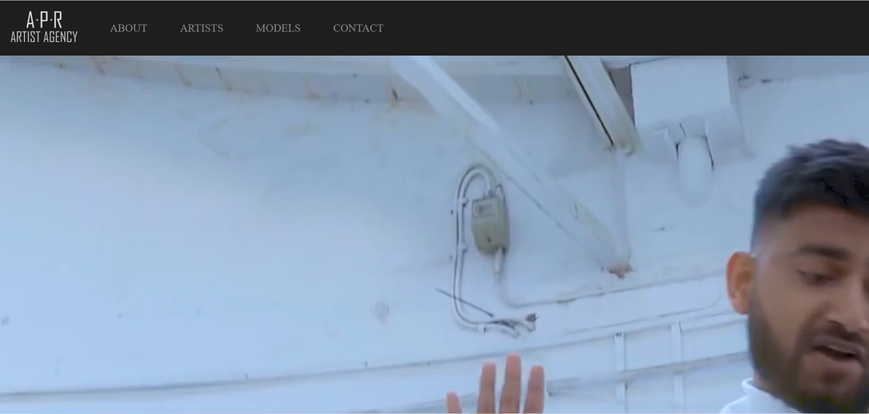
NISH
British Bengali singer, songwriter and producer.
Pioneering a new brand of urban Bengali music with fusion of English
Punjabi, Hindi, Arab etc.

Slide 2
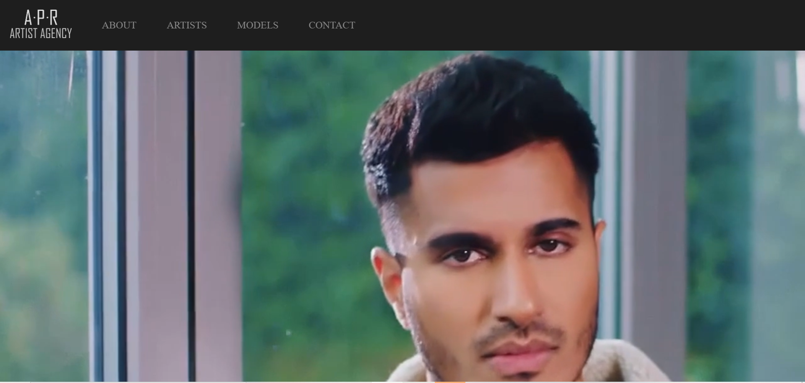

Arjun
Sri Lankan-British singer, songwriter and producer.
Arjun is known for his fusion of contemporary Western and Eastern sounds,
combining R&B with elements of South Asian music.

Slide 3
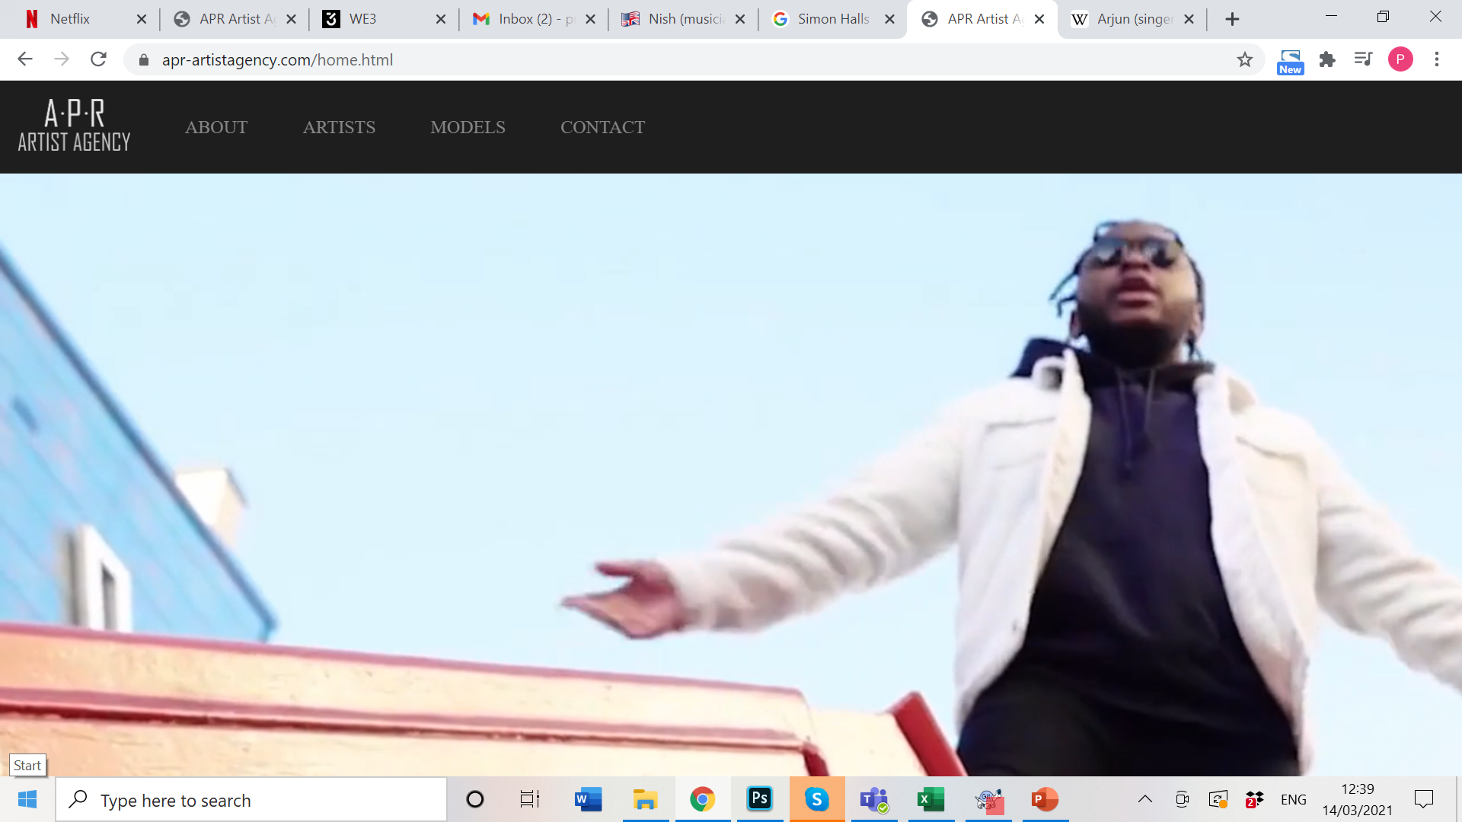
Ishy Dee
British Singer-songwriter, multi instrumentalist and Producer.
Debut EP ‘Calling’ was a labour of love – seven R&B tracks
With stadium-ready club beats still true to the underground.

Slide 4
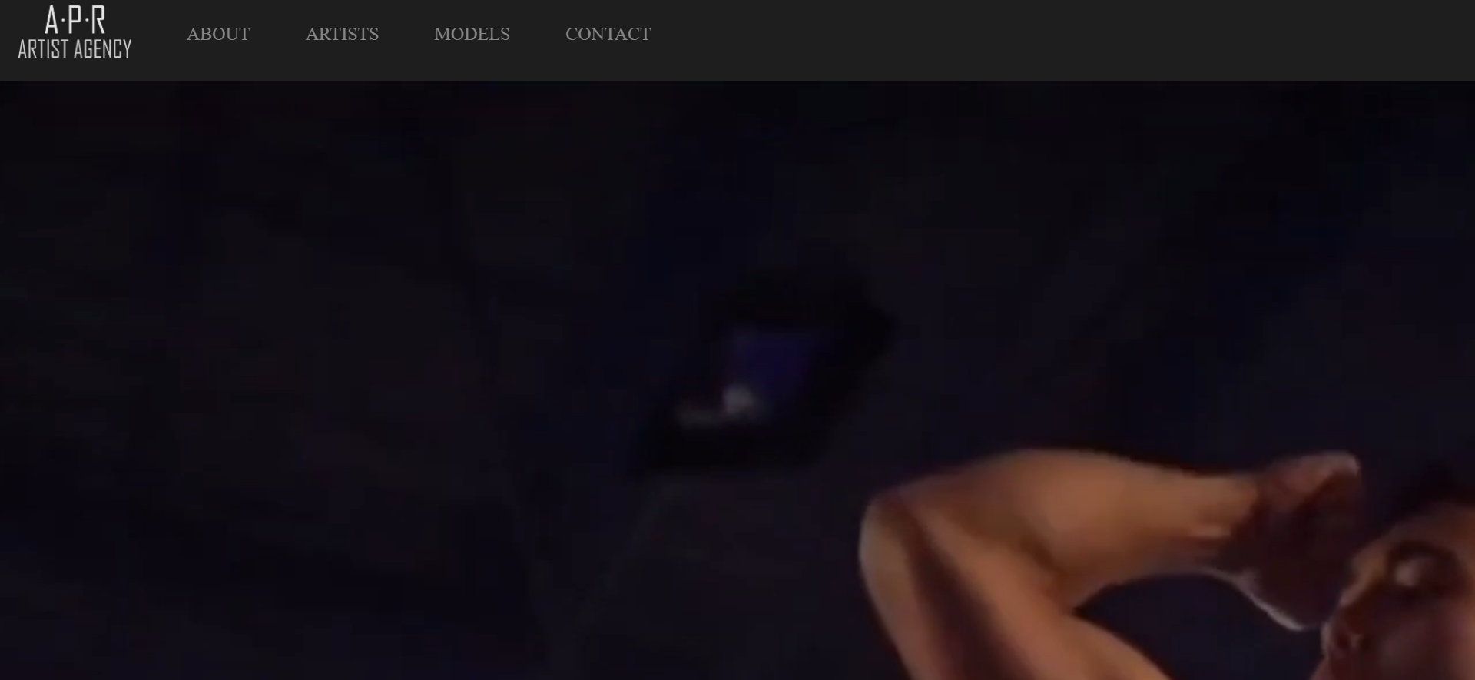
Carlos Zamora
First ever Danish WWE Try Out attendee,
professional wrestler and MMA fighter,
Person Trainer, Tennis Coach and Model

